Slide 1
Early Middle Ages

Slide 2
Impact of the Fall of Roman Empire
Disruption of trade that leads to collapse of businesses, destruction of economic centers, & scarcity of money as a result of invasions
Downfall of cities as centers of administration
Shift to a rural population as Roman citizens abandoned destroyed cities

Slide 3
Impact of the Fall of Roman Empire
Decline of learning since Germanic invaders could not read or write
Loss of a common language as Latin changes & different dialects develop
Change in the concept of gov’t from one of loyalty to public gov’t & written law shifts to governance through unwritten laws & traditions

Slide 4
Germanic Kingdoms Unite Under Charlemagne
Missionaries spread Christianity
Authority in medieval Europe based on the Church
Gregory I, (Gregory the Great) became pope.
As head of the Church in Rome, Gregory broadened the authority of the papacy, or pope’s office, beyond its spiritual role.

Slide 5
Clovis I extends rule over what is now France.
Brings Christianity to the Franks
Charles Martel extended the Franks’ reign to the north, south, and east.
He also defeated a Muslim raiding party from Spain at the Battle of Tours in 732, stopping the Muslim invasion of Western Europe.

Slide 6
Charlemagne spread Christianity.
He reunited western Europe for the first time since the Roman Empire.
800, Charlemagne traveled to Rome to crush an unruly mob that had attacked the pope.
Pope Leo III crowned him emperor.
Charlemagne spread learning & tried to revive culture.

Slide 7
Vikings
More invasions of Europe:
Magyars & Slavs from the east, invade Germany, France & Spain
Vikings from the north; using long boat spread death &destruction; through out W. Europe.
Created communities Danelaw, (England), Normandy (France), & places in Sicily

Slide 8
Feudalism in Europe (800-1400)
In exchange for military protection & other services, a lord, or landowner, granted land called a fief.
The person receiving a fief was called a vassal.
People classified into 3 groups:
those who fought (nobles and knights)
those who prayed (men and women of the Church
those who worked (the peasants)
Social class was usually inherited.

Slide 9
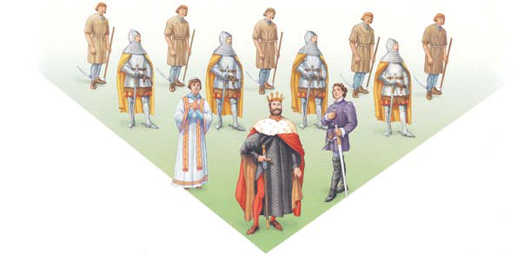
Feudal Pyramid
Peasant
Knight
Church official
Noble
King

Slide 10
Serfs
Most people were peasants.
Most peasants were serfs.
Serfs were people who could not lawfully leave the place where they were born.
Though bound to the land, serfs were not slaves.
They could not be bought or sold
The wealth of the feudal lords came from the labor of peasants.

Slide 11
Manors: The Economic Side of Feudalism
The manor was the lord’s estate.
During the Middle Ages, the manor system was the basic economic arrangement.
The manor system rested on a set of rights and obligations between a lord & his serfs.
The lord provided the serfs with housing, strips of farmland, and protection from bandits.
In return, serfs tended the lord’s lands, cared for his animals, and performed other tasks to maintain the estate

Slide 12
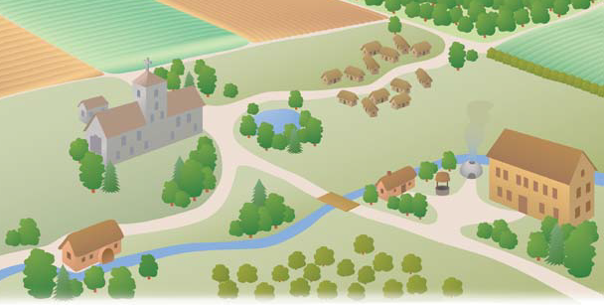
Fallow Field
Spring Planting
Field
Fall Planting
Field
serfs
Church
Blacksmiths
Manor
Mill

Slide 13
Peasants paid a tax on all grain ground in the lord’s mill.
To dodge taxes by baking bread elsewhere was treated as a crime.
Peasants paid a tax on marriage.
Weddings took place only w/ the lord’s consent.
peasant families owed the village priest a tithe, or church tax.

Slide 14
Women in the middle Ages
Role of women determined by catholic church & nobility.
Women inferior b/c of Eve’s disobedience in the Garden of Eden.
People lived in large extended families.
Women of all classes gave birth to lot of children, most died in child birth

Slide 15
Noble women spent time in prayer & sewing & domestic chores.
Few were educated.
Peasant wives worked w/ husband sides by side in the fields.
Women also looked after the home & livestock

